Slide 1
Recipient Training
Illinois Office of the Attorney General

Slide 2
Agenda
Welcome & Overview
How to add user
Financial quarterly reporting:
  Entering Expenses
  Submitting a Reporting Period
  Submitting a Payment Request
Performance Reports:
  Entering Achievements
  Submitting a Reporting Period
Submitting an Amendment Request
Support Resources
Q&A

Slide 3
In-Product Review

Slide 4
Summary of Required Actions
Administration: Log-in to AmpliFund & add relevant users to your account and invite them
Grant Management: Update the Recipient Grant Manager
Post Award Management:
  Enter Expenses
  Close Budget Reporting Period
  Submit Payment Request
Post-Award > Performance > Performance plan > trophy icon > + sign
Post Award Management: Close Performance Reporting Period
As Needed:
Submit amendment request
Payment Request naming convention: Quarter 1, Quarter 2, etc.
Note: Quarter 1 = Contract payment (25% of grant amount)

Slide 5
Support

Slide 6
AmpliFund Support
Submit a support ticket:
support@amplifund.zendesk.com
Visit the support portal:
https://amplifund.zendesk.com
Supported Browsers:
Google Chrome (current supported releases)
Mozilla Firefox (current supported releases)
Microsoft Edge (current supported releases)
Apple Safari 10+

Slide 7
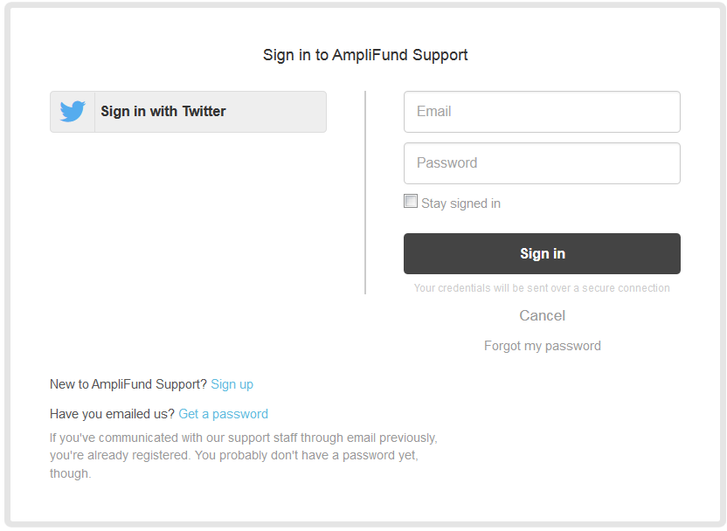
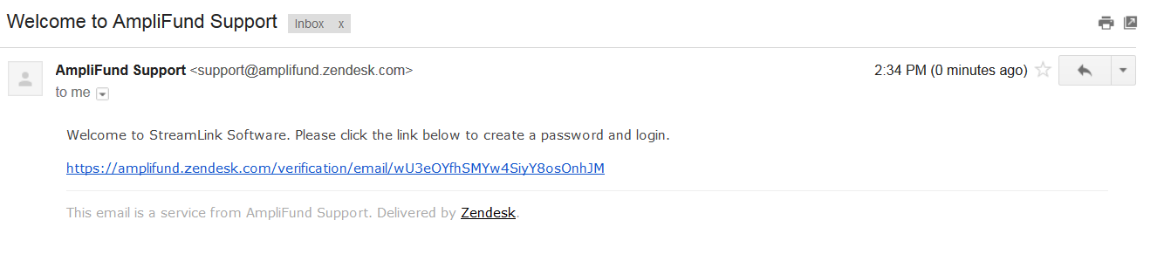
AmpliFund Support Site
Go to https://amplifund.zendesk.com
Click the Sign up link
Enter your full name
Enter your email address
Complete the I’m not a robot check
Click the Sign up button
A welcome email from support@zendesk.com will be sent to you via email
Click the link to set your password

Slide 8
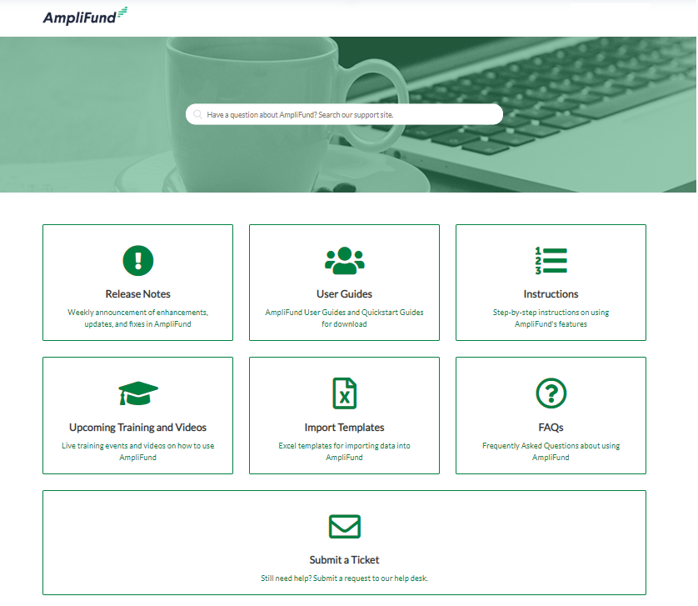
AmpliFund Support Site

Slide 9
Thank You
www.gotomygrants.com

Slide 10
Appendix
Support Slides

Slide 11
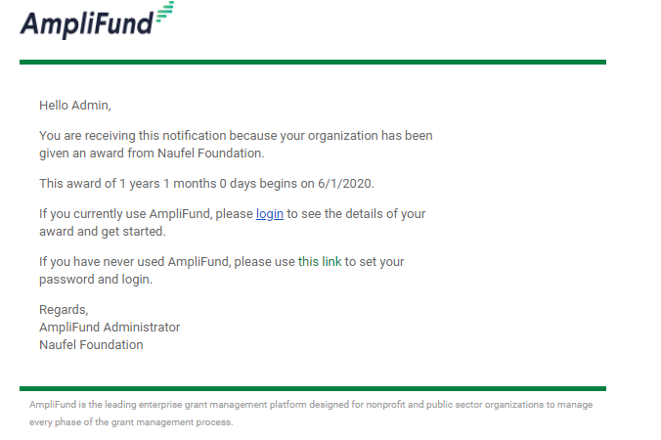
Award Activation
Account owner will use this link to set-up log-in and can add additional users.
Funder name
#
#
Award Start Date
Funder name
AmpliFund emails come from no-reply@gotomygrants.com

Slide 12
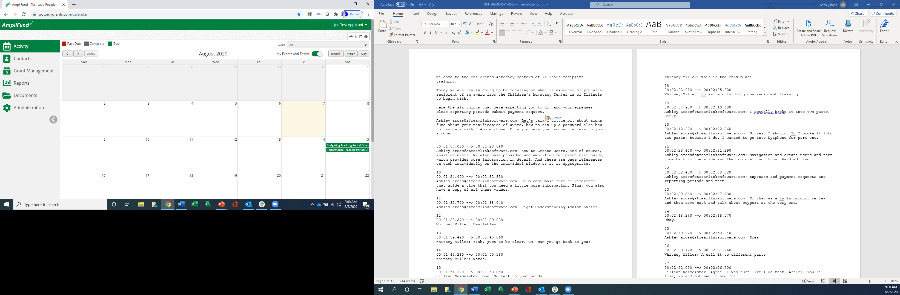
Navigating AmpliFund
2
3
Left Navigation -shows on every page
User Navigation –includes account information, change password, message center, support, terms and conditions, applicant portal, and logout
Options Toolbar –displays icons to perform functions available on the current page, icons vary based on page
1
1

Slide 13
Adding Users

Slide 14
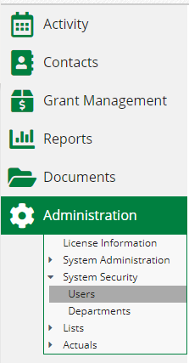

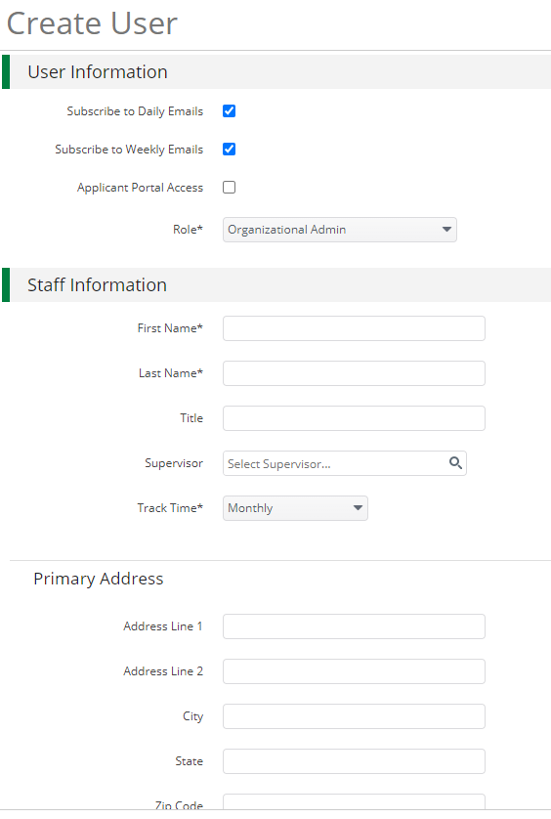
Creating Additional Users
1
Open Administration > System Security > Users
Click the + icon in the top right hand corner to create a User
Enter user preferences & information
  Select the User’s Email Preference
  User role
  User’s First Name, Last Name, and E-Mail Address
Click the ‘Create’ button
2
3

Slide 15
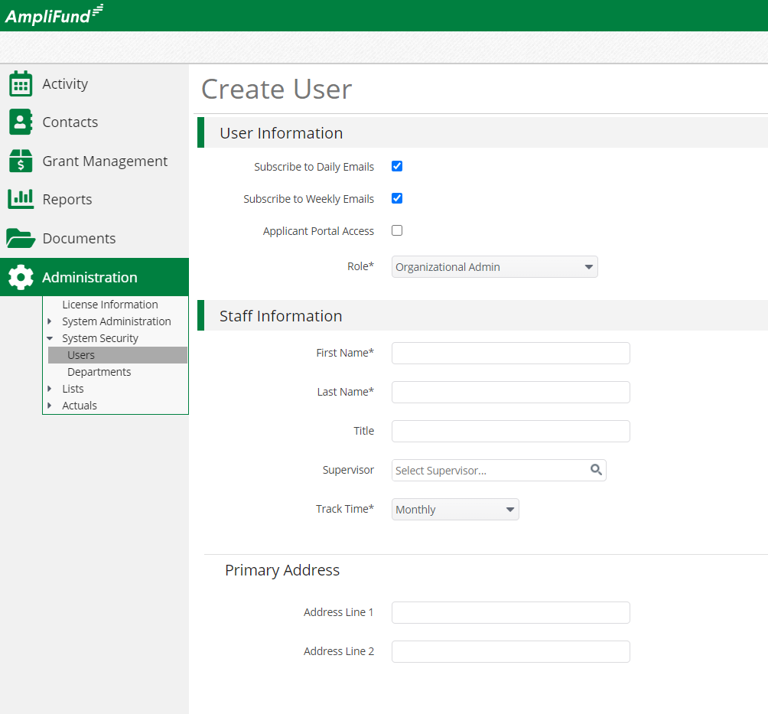
User Options
Subscribe to Daily/Weekly Emails
  Set to Yes to receive daily and/or weekly emails from AmpliFund with tasks/reminders
Applicant Portal Access
  Set to Yes to provide a user in your organization with access to submit applications
Role*
  Organization Administrator
    Full view and edit access to your organization’s AmpliFund account
  Executive
    View only access to your organization’s AmpliFund account
  Department User (No Salary)
    Only has access to budget or performance plan items to which you assign the user as the Responsible Individual
  Department User (Salary)
    Has access to budget or performance plan items to which you assign the user as the Responsible Individual including personnel line items

Slide 16
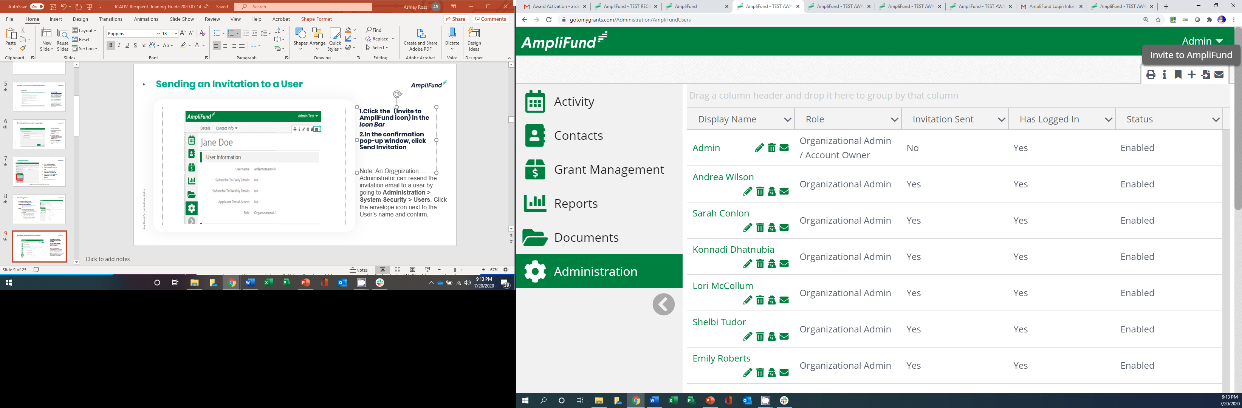

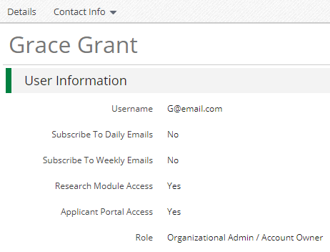
Sending an Invitation to a User
Click the in the Icon Bar
In the confirmation pop-up window, click Send Invitation
Link is active for 72 hours
Note: An Organization Administrator can resend the invitation email to a user by going to Administration > System Security > Users. Click the envelope icon next to the User’s name and confirm.

Slide 17
Updating Grant Award

Slide 18
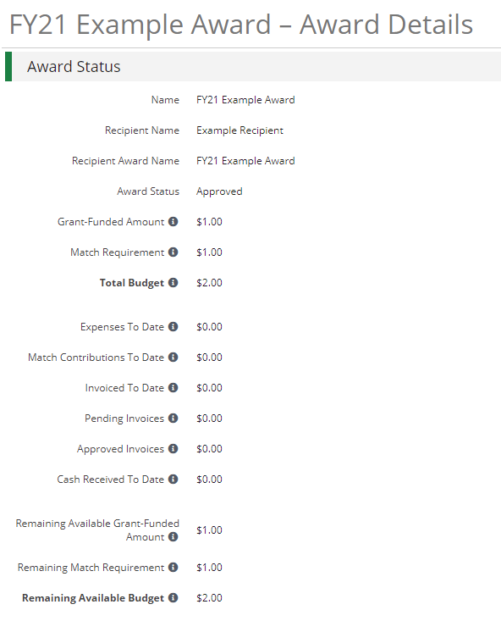

Updating Grant Award Details
Go to Grant Management > Grants
Click the ‘pencil’ icon next to grant name to edit
Update the Recipient Grant Manager name & add Recipient award name (optional)
Click the Save button in the right corner of the screen
3
1
2
Grant Performance Plans and Budgets have already been created in your account.
*Page 10 of the AmpliFund Recipient User Guide

Slide 19
Accessing Budget

Slide 20
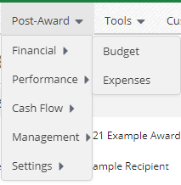
Accessing Budget
Go to Grant Management > Grants
Click the grant name
Click on Post Award>Financial>Budget
3
1
2
Grant Performance Plans and Budgets have already been created in your account.
*Page 10 of the AmpliFund Recipient User Guide

Slide 21
Expense Entry

Slide 22
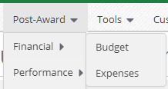
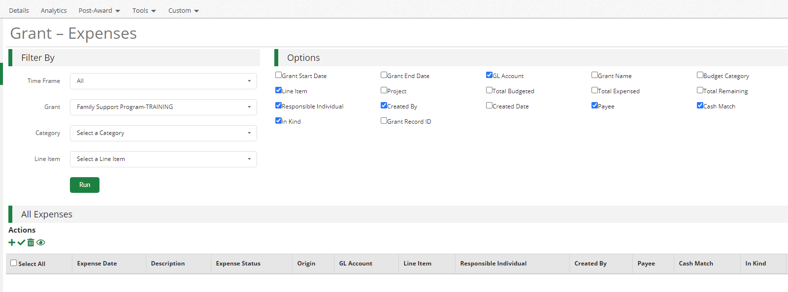
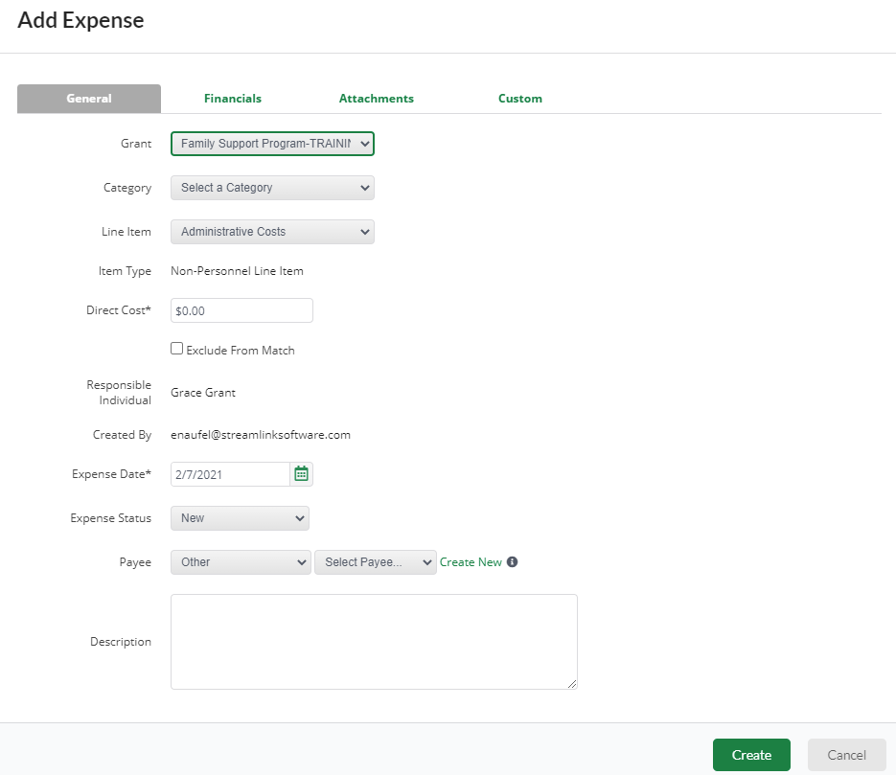
Expense Entry
From the Grant click on Post Award>Financial> Expenses
Click on the plus icon to add a new expense
Add expense information under expense tab & attachments then click Create
1
2
3

Slide 23
Submitting a Reporting Period & Payment Request

Slide 24
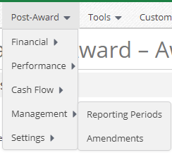
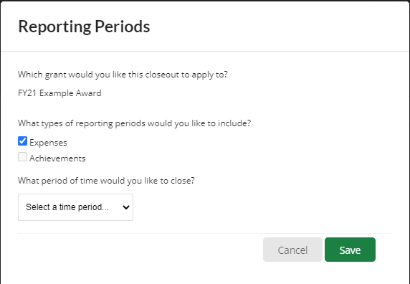

Generating a Reporting Period
From the Grant click on Post Award>Management>Reporting Periods
Click on the plus icon in the upper right hand corner
Select Expenses and Time Period then click Save
Review expenses & details, click Close to send completed reporting period to Funder
2
1
3
4

Slide 25
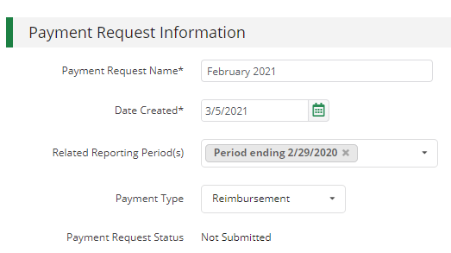
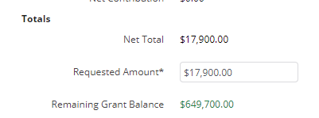
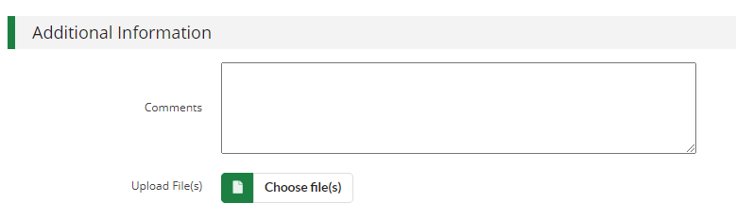

Generating a Payment Request from Reporting Period
From the Reporting Periods click on the payment request icon
Enter name (1st, 2^{nd,} 3rd, or 4th quarter) and date created (last day of quarter)
Type in total requested amount
Add any additional comments & upload files to Funder
Click submit to send to Funder
1
2
3
4
5

Slide 26
Creating & Submitting Performance Achievements

Slide 27
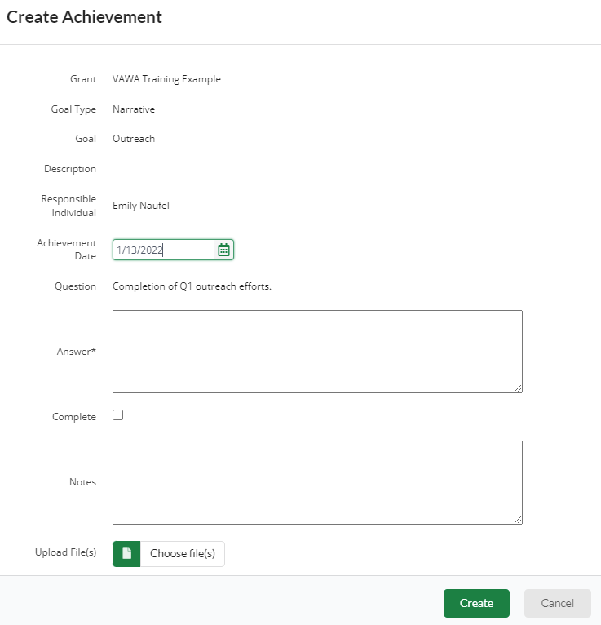
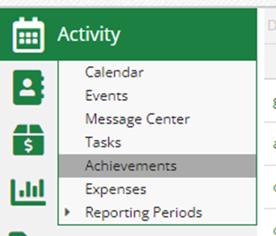

Creating Performance Achievements
Click on Activity then Achievements
Click on the plus icon next to the goal
Enter information about performance achievement and click Create
  Achievement date should be end of the quarter
  Repeat for each relevant goal
3
1
2

Slide 28
Generating a Performance Reporting Period
From the Grant click on Post Award>Management>Reporting Periods
Click on the plus icon in the upper right hand corner
Select Achievements and Time Period then click Save
Review achivements & details, click Close to send completed reporting period to Funder
2
1
3
4

Slide 29
Submitting an Amendment Request

Slide 30
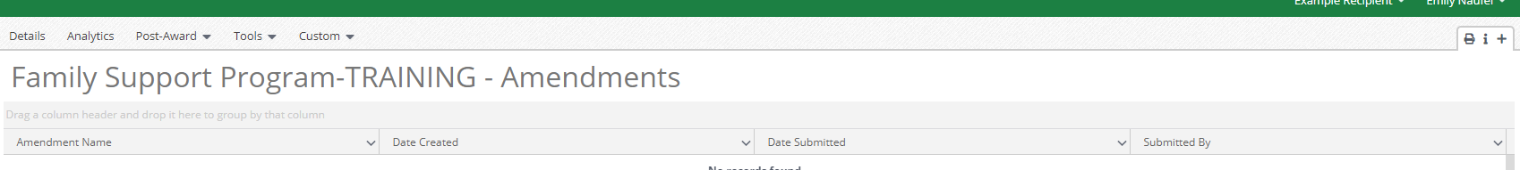
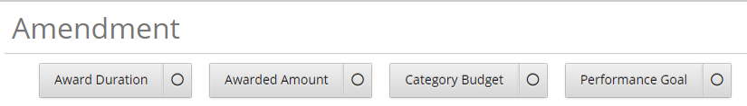

Generating an Amendment
From the Grant click on Post Award>Management>Amendments
Click on the plus icon in the upper right hand corner
Click on circle then text of amendment type
Enter amendment Information
Click Submit to Submit request to Funder
1
2
3
4

Slide 31
Available Reporting

Slide 32
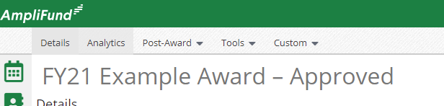
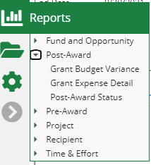
Available Reporting
Grant Dashboard
Other Reports

